Slide 1

Plumbing System
Albert Einstein was named an honorary member of the Plumbers and Steamfitters Union after publicly stating that he would become a plumber if he had to do it all over again.
Civil Engineering and Architecture
© 2010 Project Lead The Way, Inc.

Slide 2
TABLE OF CONTENTS
The Romans
Water Supply System
Drain-Waste-Vent System
Plumbing Codes
Plumbing Plans
Energy Conservation
Notes:
Civil Engineering and Architecture
Unit 2 – Lesson 2.3 – Services and Utilities
Project Lead The Way, Inc.
Copyright 2010
Heating Ventilation and Air Conditioning

Slide 3
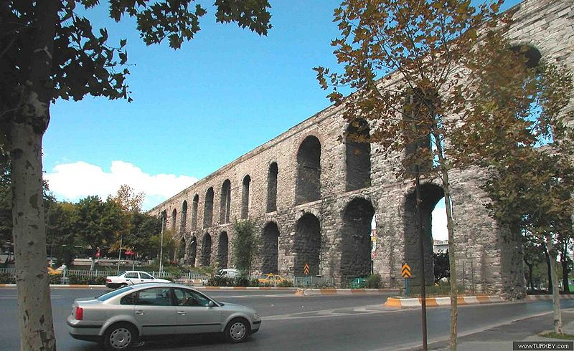
The Romans
Water Supply
Aqueducts transported water from sources
  Highest quality supplied drinking fountains
  Lower quality supplied public baths and latrines
Lead pipes transferred water to limited users
wikimedia
Notes:
The Romans are well known for their public water supply and waste water systems. However, except for the wealthy, most access points to the systems were located outside of buildings.
Civil Engineering and Architecture
Unit 2 – Lesson 2.3 – Services and Utilities
Project Lead The Way, Inc.
Copyright 2010
Heating Ventilation and Air Conditioning

Slide 4
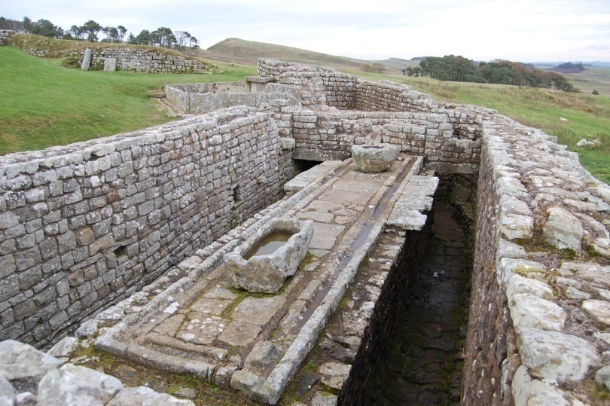
The Romans
Wastewater System
Chamber pots in residences
  Dumped out windows
Toilets (luxury)
  Hole in the floor drained to cesspool below
Public latrines
  Wastewater flowed through central channel into main sewage system and into nearby rivers and streams
Few private wastewater system connections
wikimedia
Notes:
Civil Engineering and Architecture
Unit 2 – Lesson 2.3 – Services and Utilities
Project Lead The Way, Inc.
Copyright 2010
Heating Ventilation and Air Conditioning

Slide 5
Plumbing System
Water supply pipes
Fixture – A device that uses water (sink, toilet, dishwasher, etc.)
Soil, waste, and vent pipes
Drain and sewer
Gas pipes
Storm water drainage
Notes:
A plumbing system consists of all of the elements that provide water or convey water or wastewater within the building as well as those elements that vent the wastewater system. Often gas and storm water drain pipes are also installed and are considered part of the plumbing system.
Civil Engineering and Architecture
Unit 2 – Lesson 2.3 – Services and Utilities
Project Lead The Way, Inc.
Copyright 2010
Heating Ventilation and Air Conditioning

Slide 6
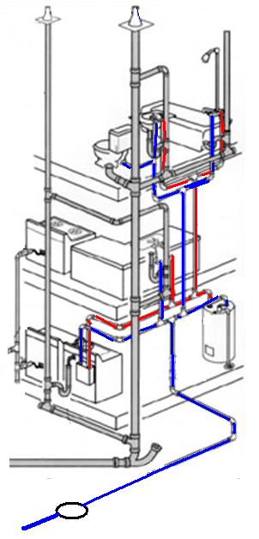
Water Supply System
Network of pipes that transport hot and cold potable water under pressure
Fixture – A device that uses water (sink, toilet, dishwasher, etc.)
Water Heater – Large insulated tanks that heat cold water to be distributed in the hot water supply lines
Trunk Lines – Hot or cold water pipes that serve many fixtures
Branch Lines – Hot or cold water pipes that serve only one or two fixtures
Notes:
[Note that yellow arrows point to each component as it is defined]
Civil Engineering and Architecture
Unit 2 – Lesson 2.3 – Services and Utilities
Project Lead The Way, Inc.
Copyright 2010
Heating Ventilation and Air Conditioning

Slide 7
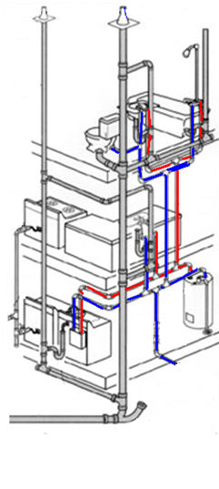
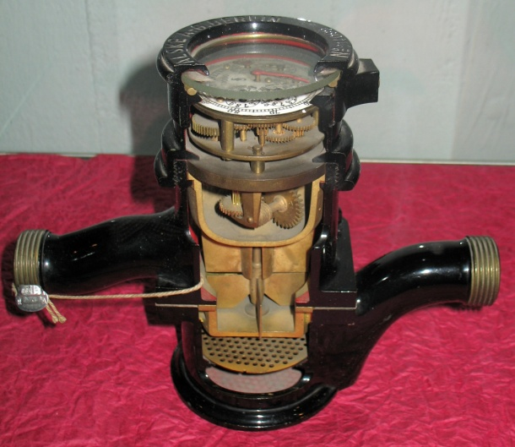
Water Supply System
Water Main – Supply pipe installed and maintained by a public entity and on public property
Water Service – Pipe from the water main to the building supply pipes
Meter – Measures the amount of water transported through water service
Valve – A fitting used to control water flow (located next to the meter)
SERVICE
MAIN
Notes:
Civil Engineering and Architecture
Unit 2 – Lesson 2.3 – Services and Utilities
Project Lead The Way, Inc.
Copyright 2010
Heating Ventilation and Air Conditioning

Slide 8
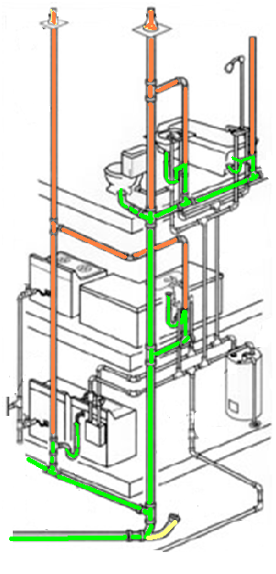
Drain-Waste-Vent System
Network of pipes that transport wastewater and sewer gases from the building
Drain Pipe – A pipe that carries wastewater in a building
Vent Pipe – A vertical pipe that provides circulation of air to and from the drainage system
Trap – A fitting (usually U-shaped) that provides a seal to prevent the flow of sewer gases
Stack – A vertical pipe (waste or vent) that extends through at least one story
Cleanout – An access opening to allow cleanout of the pipe
Notes:
The drain-waste-vent system is designed to safely convey the waste and waste water from the building while allowing noxious gases created from sewage to escape to the exterior of the building.
In the diagram the drain piping is shown in green and the vent piping is shown in orange
Civil Engineering and Architecture
Unit 2 – Lesson 2.3 – Services and Utilities
Project Lead The Way, Inc.
Copyright 2010
Heating Ventilation and Air Conditioning

Slide 9
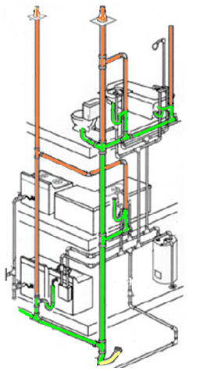
Drain-Waste-Vent System
Sewage – Any liquid waste containing animal or vegetable matter, including liquids containing chemicals
Sanitary Sewer – A sewer pipe that carries only sewage
Storm Sewer – A sewer pipe that carries storm water or other drainage (but not sewage)
Building Sewer or Sewer Lateral – Part of the drainage system from the building to the public, private, or individual sewer disposal system
Sewer Main – A sewer pipe installed and maintained by a public entity and on public property
LATERAL
MAIN
Notes:
A sanitary sewer is distinguished from a storm sewer by the type of water that it carries. If sewage is conveyed, the sewer is a sanitary sewer. If the water conveys storm water, it is called a storm drain.
The part of a building’s drainage system that extends from the building to the disposal system is often called a sewer lateral. The wastewater disposal system can be a municipal system, a private system, or an individual system. We will discuss these wastewater systems later in Unit 3.
Civil Engineering and Architecture
Unit 2 – Lesson 2.3 – Services and Utilities
Project Lead The Way, Inc.
Copyright 2010
Heating Ventilation and Air Conditioning

Slide 10
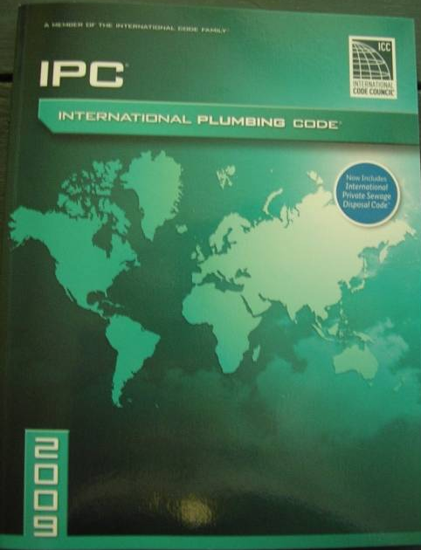
Plumbing Codes
Protect health and safety of community
Reduce potential for widespread disease
Provide rules and regulations for installing drinking water or sewer facilities
Identify required methods for installing plumbing systems
Provide permits and inspections
The International Residential Code includes requirements for residential plumbing systems.
International Plumbing Code is a model code that has been widely adopted throughout the United States for non-residential facilities
Notes:
Civil Engineering and Architecture
Unit 2 – Lesson 2.3 – Services and Utilities
Project Lead The Way, Inc.
Copyright 2010
Heating Ventilation and Air Conditioning

Slide 11
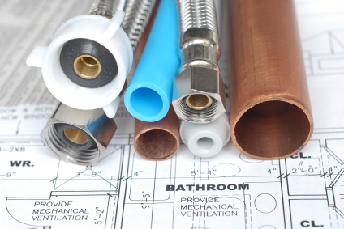
Plumbing Codes
Supply pipe size dependent upon
  Amount of water
  Water pressure
  Pipe length
  Number of stories
  Flow pressure necessary at farthest point in system
Drainage and vent pipe size dependent upon
  Plumbing Fixture Units
      Type of fixture
      Estimated amount of waste
©iStockphoto.com
Notes:
Civil Engineering and Architecture
Unit 2 – Lesson 2.3 – Services and Utilities
Project Lead The Way, Inc.
Copyright 2010
Heating Ventilation and Air Conditioning

Slide 12
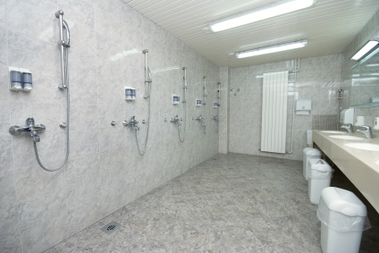
Plumbing Codes
For non-residential facilities
IBC Chapter 29 – Plumbing Systems
Minimum number of plumbing facilities
  Water closets
  Lavatories
  Bathtubs/showers
  Drinking fountains
  Other fixtures
Location of toilet facilities
Toilet room requirements
©iStockphoto.com
Notes:
Although the International Plumbing Code provides requirements for all aspects of a building’s plumbing system, the IBC incorporates a few of the plumbing regulations including the minimum number of certain plumbing fixtures, the location of toilet facilities, and the design of the toilet room and partitions.
The picture shows a row of showers and lavatories in a sports club.
Civil Engineering and Architecture
Unit 2 – Lesson 2.3 – Services and Utilities
Project Lead The Way, Inc.
Copyright 2010
Heating Ventilation and Air Conditioning

Slide 13
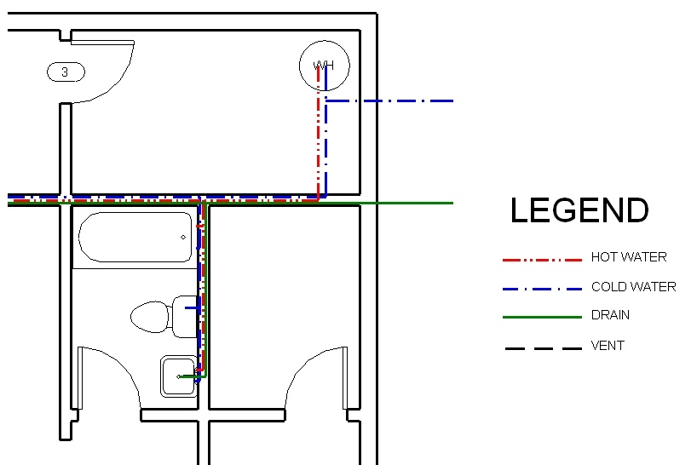
Plumbing Plan
Notes:
Plumbing plans are used to show the location of the water supply, vent, and drain lines but may also include storm water drains and gas lines. Note the difference in the line types. Color has been used here to better differentiate between the various lines; however, most plumbing plans will be black and white. The line style is used to differentiate the various types of pipe. Be sure to record the line style and color of each pipe. You will need this information for the next activity.
This plumbing plan was created with Revit software. New detail line styles were defined.
Civil Engineering and Architecture
Unit 2 – Lesson 2.3 – Services and Utilities
Project Lead The Way, Inc.
Copyright 2010
Heating Ventilation and Air Conditioning

Slide 14
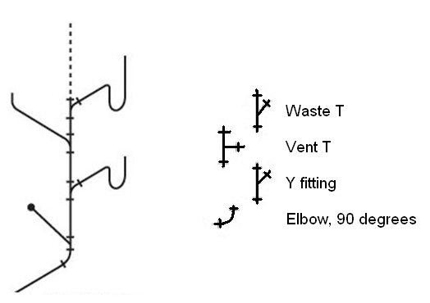
Plumbing Plans – Isometric
Notes:
Another common type of plumbing views is an isometric. This drawing illustrates a drain-waste-vent (DWV) system. Although not common for residential systems, isometrics are often created for larger commercial facilities due to the complexity of the piping. Note that toilets often have traps incorporated into their design and therefore do not require an additional trap in the system.
Also note that the connections in the sanitary drains are Y-shaped and not T-shaped to facilitate movement of waste.
Many software packages such as Revit MEP (mechanical, electrical, and plumbing) can create isometric piping drawings.
Civil Engineering and Architecture
Unit 2 – Lesson 2.3 – Services and Utilities
Project Lead The Way, Inc.
Copyright 2010
Heating Ventilation and Air Conditioning

Slide 15
Energy Conservation
Locate hot water heater in conditioned space
Insulate hot water heater
Insulate exposed hot water pipes
Insulate cold water pipes with freezing potential
Place water pipes in interior walls, if possible
Use low-flow fixtures
Seal all wall fenestrations
Notes:
These design tips will provide energy savings when designing a plumbing system.
Civil Engineering and Architecture
Unit 2 – Lesson 2.3 – Services and Utilities
Project Lead The Way, Inc.
Copyright 2010
Heating Ventilation and Air Conditioning

Slide 16
TABLE OF CONTENTS
The Romans
Water Supply System
Drain-Waste-Vent System
Plumbing Codes
Plumbing Plans
Energy Conservation
Notes:
Civil Engineering and Architecture
Unit 2 – Lesson 2.3 – Services and Utilities
Project Lead The Way, Inc.
Copyright 2010
Heating Ventilation and Air Conditioning

Slide 17
Image Resources
www.istock.com. Images retrieved December 8, 2009.
www.wikimedia.com. Images retrieved December 8, 2009.
Notes:
Civil Engineering and Architecture
Unit 2 – Lesson 2.3 – Services and Utilities
Project Lead The Way, Inc.
Copyright 2010
Heating Ventilation and Air Conditioning

